Slide 1


Slide 2


Quantum-Enhanced Anomaly Detection for QoS Degradation in Microservices Applications
Final Year Project Synopsis
Submitted by
ROLL | NAME
2301201089 | CHIRAG
2301201125 | RAGHVENDRA SINGH
Faculty Mentor: MS. Jyoti Yadav
Notes:
New Courses replaced with New Programmes

Slide 3

Project Overview
Microservices produce massive, diverse, and rapidly changing runtime data.
The Struggle: Traditional ML/DL fails to handle the complex, nonlinear interactions between distributed services.
The Bottleneck: Classical models require manual feature engineering; Deep Learning requires massive labeled data (rarely available).
The Result: High overhead and slow detection, leading to unreliable system performance.
Notes:
New Courses replaced with New Programmes

Slide 4
Specific Objectives
Analyze Distributed Nature: Understand how service interactions lead to QoS degradation.
Identify Anomalies: Categorize failures into Performance (latency) and Resource (CPU/Memory) issues.
Apply Advanced Learning: Implement Quantum-enhanced techniques to bridge the gap left by classical models.
Evaluation: Compare Quantum vs. Classical models for reliability and speed.
Notes:
New Courses replaced with New Programmes

Slide 5
Proposed Solution
Framework: A dedicated microservices anomaly detection framework.
Quantum Integration: Using Quantum Machine Learning (QML) to process high-dimensional telemetry data.
Experimental Benchmarking: Comparing detection performance using real or simulated microservices data.
Deliverables: Implementation code, performance results, and system documentation.
Notes:
New Courses replaced with New Programmes

Slide 6
Why "Quantum-Enhanced"?
Non-linear Mapping: Quantum circuits are mathematically superior at finding patterns in distributed "noise.“
Data Efficiency: Can often detect anomalies with smaller datasets compared to Deep Learning.
Feature Space: Uses Hilbert Space to separate "Normal" from "Anomalous" behavior more clearly.
Notes:
New Courses replaced with New Programmes

Slide 7
Technology Stack
Architecture: Microservices (Docker, Kubernetes)
Quantum Layer: Qiskit or PennyLane (Quantum Simulators)
Programming: Python (NumPy, Pandas, Scikit-Learn)
Data Monitoring: Prometheus or Synthetic Trace Data
Notes:
New Courses replaced with New Programmes

Slide 8
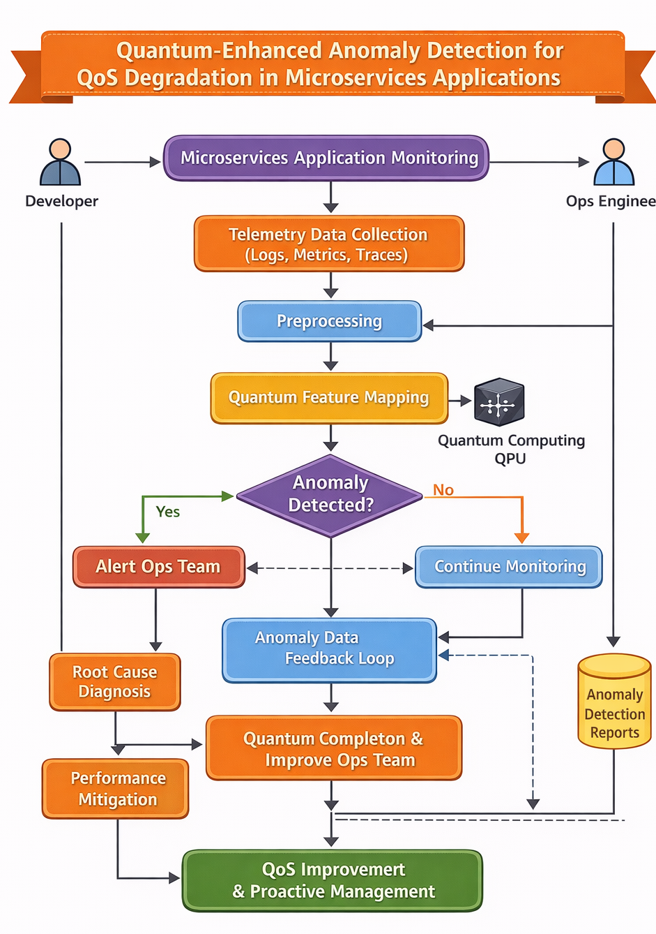

Slide 9
Expected Outcomes
Higher Accuracy: Improved detection of QoS degradation.
Early Detection: Identifying failures before they cascade through the system.
Research Insight: Feasibility of using Quantum models in real-world DevOps environments.
Notes:
New Courses replaced with New Programmes

Slide 10
Methodology
The project was developed using the MERN stack following a structured approach. Initially, system requirements were analyzed to understand inventory management needs. The application architecture was designed with role-based access for Admin and Normal Users. The frontend was developed using React.js to provide a responsive and user-friendly interface. Backend services were implemented using Node.js and Express.js to handle business logic and REST APIs. MongoDB was used for secure data storage. Authentication was implemented using JWT and Google OAuth. Finally, the system was tested and validated to ensure secure access, accurate inventory management, and proper functionality.
Notes:
New Courses replaced with New Programmes

Slide 11
Expected Results & Impact
Expected Results:
Successful authentication using Email/Password and Google OAuth
Accurate role identification for Admin and Normal Users
Real-time inventory updates after product or order operations
Impact:
Improves efficiency of warehouse inventory management
Reduces operational errors and stock inconsistencies
Enhances decision-making using analytical dashboards
Notes:
New Courses replaced with New Programmes

Slide 12
Project Timeline
Phase 1 (Week 1–2): Exploration & Planning.
Phase 2 (Week 3–4): Environment Setup & Data Preparation
Phase 3 (Week 5–7): Implementation.
Phase 4 (Week 8-9): Evaluation & Testing.
Phase 5 (Week 10): Documentation & Presentation.
Notes:
New Courses replaced with New Programmes

Slide 13
THANK YOU

